Slide 1
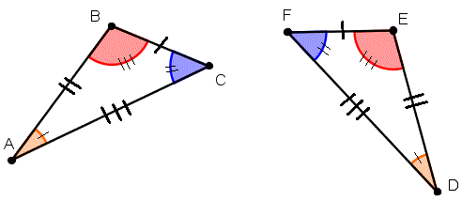
My Geometry Interactive Notebook
Name:
Class: 9-5
Teacher: Miss L
Term 2 Semester 1

Slide 2
24
7
30
Topic: Similar Triangles
Date
EQ - How can I determine if two triangles are similar?
When you increase the size of the object
Enlargements
When working out enlargements, you will need to know the scale factor and centre of enlargement.
The scale factor tells us by how much the object has been enlarged.
The centre of enlargement tells us where the enlargement is being measured from.
What is Enlargement?

Slide 3
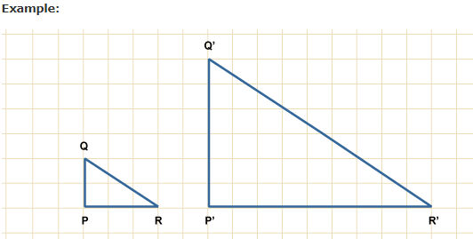
24
7
30
Topic: Similar Triangles
Date
EQ - How can I determine if two triangles are similar?
P'Q' = 3 × PQ
Q'R' = 3 × QR
P'R' = 3 × PR
Therefore, we say that the transformation is an enlargement with scale factor 3.

Slide 4
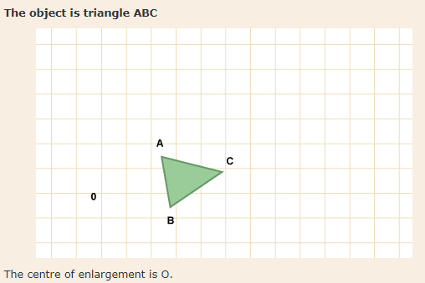
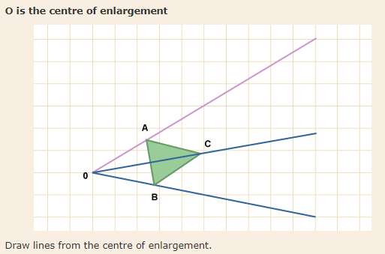
24
7
30
Topic: Similar Triangles
Date
EQ - How can I determine if two triangles are similar?
You may be asked to enlarge a shape with a given centre of enlargement. Look through this slideshow to see an example.
To enlarge an object, scale factor 2.

Slide 5
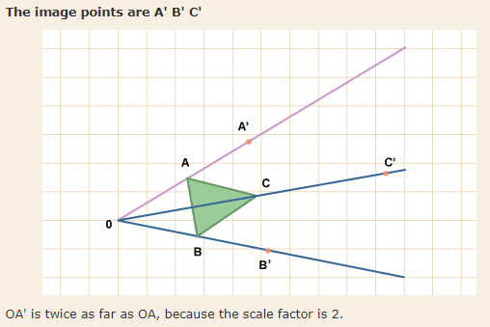
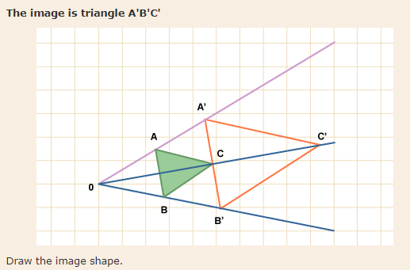
24
7
30
Topic: Similar Triangles
Date
EQ - How can I determine if two triangles are similar?
You may be asked to enlarge a shape with a given centre of enlargement. Look through this slideshow to see an example.
To enlarge an object, scale factor 2.

Slide 6
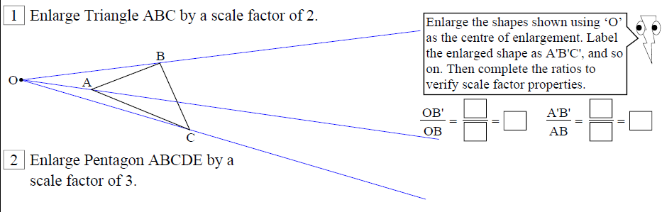
Task

Slide 7
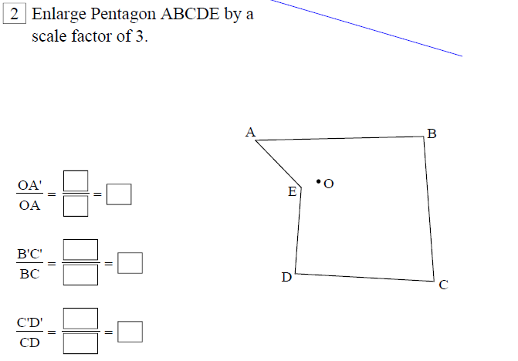
Task

Slide 8
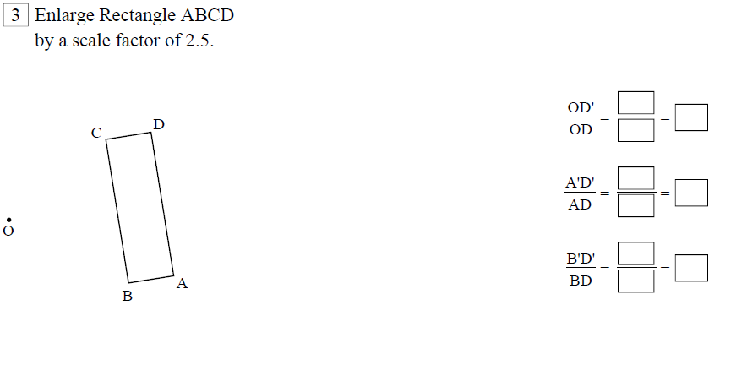
Task

Slide 9
Similar Triangles
Can be overlayed one on top of the other – so it’s easy to see corresponding angles are equal

Slide 10
If 2 triangles are similar, then their matching pairs of sides are in ratio
d
b
c
a
e
f
Provided they’re similar, that is, the angles of one are equal to angles of the other

Slide 11
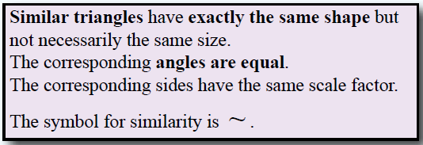
24
7
30
Topic: Similar Triangles
Date
EQ - How can I determine if two triangles are similar?
What are Similar Triangles?

Slide 12
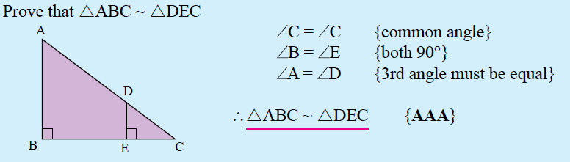
Examples

Slide 13
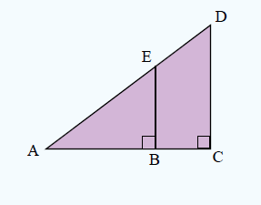
Examples

Slide 14
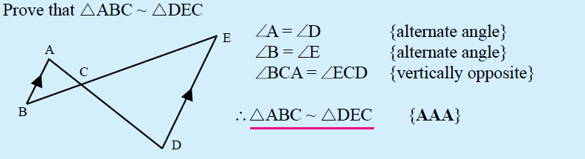
Examples

Slide 15
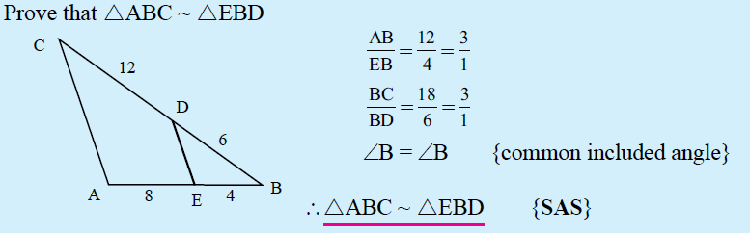
Examples

Slide 16
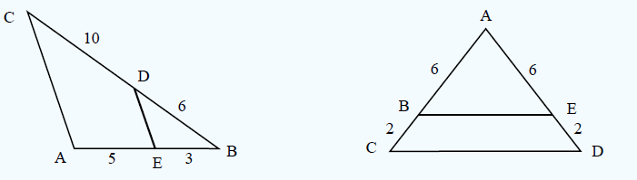
Examples

